Slide 1
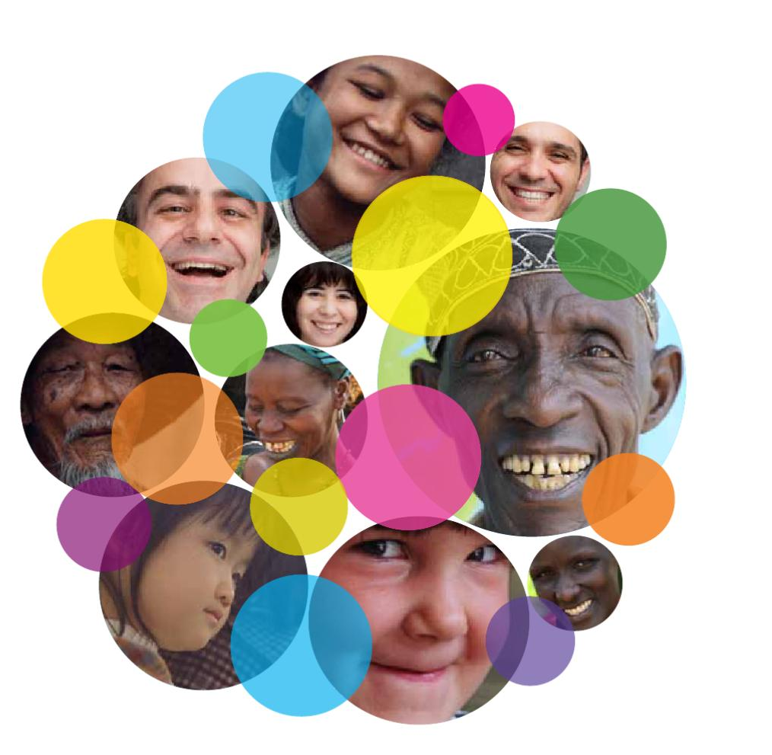
WORLD HAPPINESS REPORT – DATA ANALYSIS
How Happy is the World?
Presented By: Arpit Rimza

Slide 2
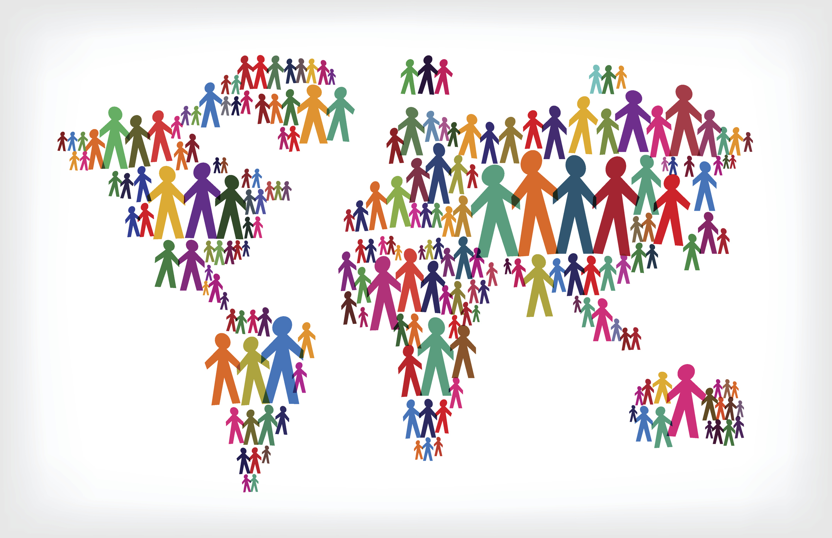
Table of Content
Introduction and Background
Objectives and Methodology
Analysis and Discussion
Conclusions and Recommendations

Slide 3
Introduction
How Happy is the World?
It’s generally understood that having enough money to cover your needs and wants can help you live a relatively happy, comfortable life—and may be assumed that this relationship may increase linearly as income levels grow, as well.
However, there’s much more to it than that. Happiness levels depend not just on financial security, but also on broader perceptions of one’s social support, personal freedom, and more.
Several attempts have been made to measure happiness. Global survey data are used by the World Happiness Report, which covers more than 150 nations, to report on how individuals feel about their own lives.
This also forms the basis of the World Happiness Report. The Report utilises six key variables which include: “Income, Health (life expectancy), Social Support, Generosity, Freedom, and Trust in Government (absence of corruption in business and government).

Slide 4
Introduction
This analysis of World Happiness Data is being conducted to understand how different parts of the world have changed in terms of happiness over time.
This presentation is the collection of the insights gleaned from the data of the World Happiness survey between 2015 and 2021.
In addition to pain and suffering, did the pandemic also increase generosity and social support worldwide? The Analysis will uncover many such aspects which can aid countries to make better decisions based on analysis of past data and provide a happy life to its citizens.
Having this knowledge, it can be possible for policy-makers to make people’s happiness the goal of their policies. And each of us can live a wiser life. Policy-makers worldwide may increasingly see it as an important and overarching objective of public policy.

Slide 5
Objectives/Questions to be Addressed
1.
What is the current state of the global happiness statistics and what is the distribution of each factor that contributes to it?
2.
What is the trend of the Global Happiness Score and Happiness Score across different Regions in the context of their contributing factors over the years?
3.
What is the extent of the relationship between the Happiness Score and each of its contributing factors? Which factor, on average, contributes most/least to happiness?
4.
What are the top and bottom 5 countries based on different metrics?
5.
How has Covid affected the Happiness Score and its contributing factors across the World?

Slide 6
Methodology
Understanding the Problem
Designing the Objectives/Questions to be Addressed and planning the Analysis
Data Preparation
Data Collection, Cleaning, Identifying appropriate Metrics to be used
Data Analysis
What story is data telling? Identifying the patterns and relationships between data points of the Variables
Sharing the Results/ Evidence based Solutions
Communicating the results of the analysis effectively using data-driven storytelling
Providing Recommendations
Based on the data insights, providing evidence-based recommendations to optimise decision-making

Slide 7
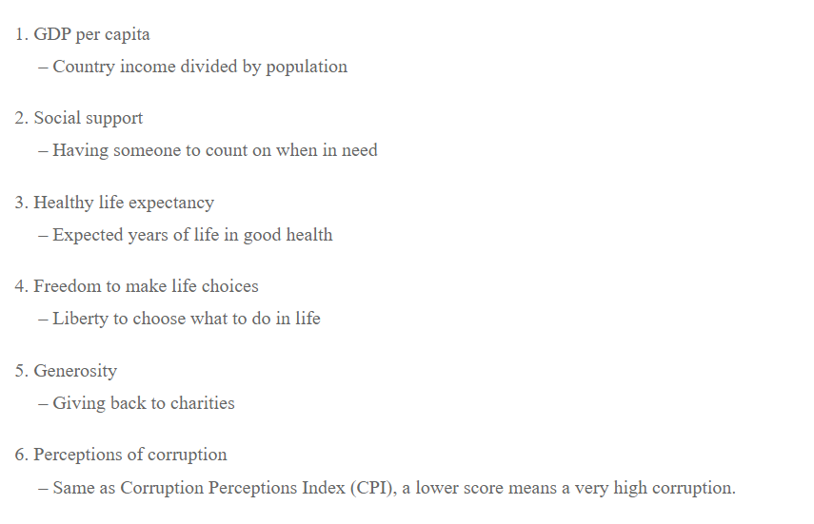
Description of the used Dataset

Slide 8
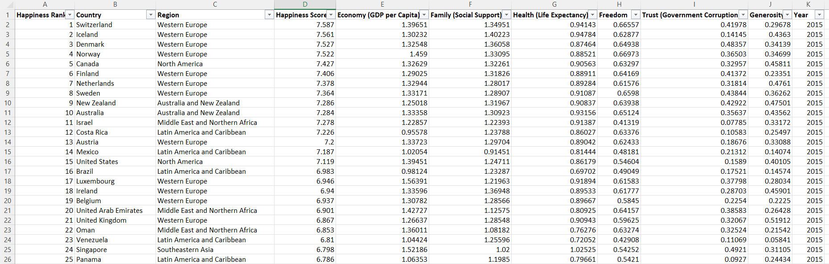
Description of the used Dataset

Slide 9
Analysis
Data Analysis
Overall Analysis
Analysis by Region
Analysis by Countries
Pre Covid (2015-2019) and Post Covid (2021)

Slide 10
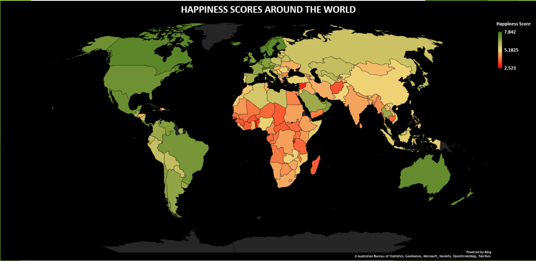
Overall Analysis
Notes:
World map - showing World at a glance and the state of global happiness.
As it can be seen, the North America, South America, Western Europe, some Arab Countries, and Australia have a good Happiness Score.
While the Happiness Score is low for Eastern and Central Europe, Africa, and Asia.

Slide 11
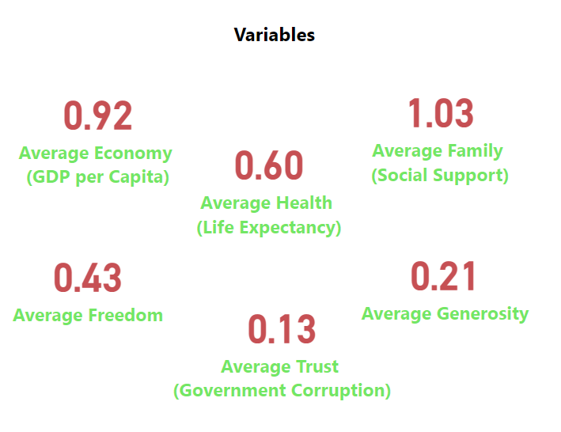
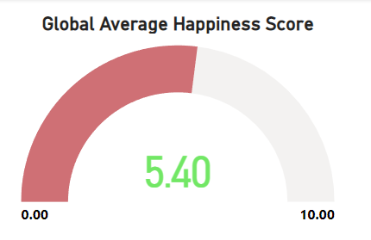
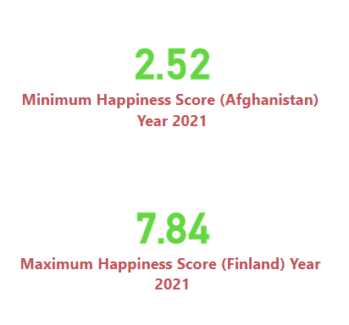
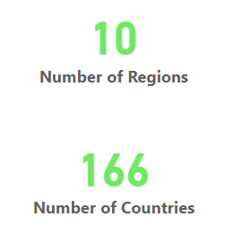
Global Happiness Statistics
Notes:
The present Global Average Happiness Score is 5.40, where the data was provided for a period of six years (2015-2019 and 2021), which was categorised into 10 Regions and 166 Countries.
Finland is the Happiest Country in the World with an Average Happiness Score of 7.84
Afghanistan is the Unhappiest Country in the World with an Average Happiness Score of 2.52
The average values of the Variables/Factors that Contribute to Happiness Scores are mentioned on the screen.

Slide 12
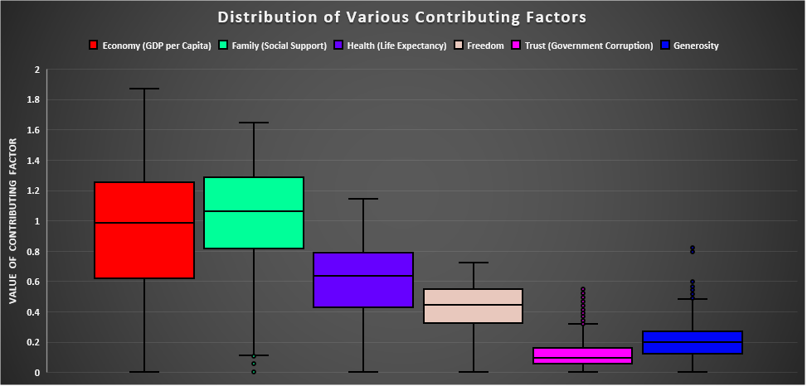
Distribution of Various Contributing Factors
Notes:
The following visual represents how various Factors contributing to the Happiness Scores are distributed
The Economy and Family (Social Support) have high values and are widely spread as compared to other values, meaning they have occupied a large range of values in the dataset
On the contrary, Trust and Generosity have low values and have the least spread, meaning these values have been consistently low for all countries

Slide 13
Happiness Score and Contributing Factors over Years
Notes:
The graph shows that the Happiness Score has marginally increased over the years from 2015-2021
The Generosity and Trust in Government have been consistently low over the years
The values of the other 4 variables have fluctuated over the years
The Health score increased until 2019 but decreased in 2021, it can be a result of the Covid-19 pandemic which affected the health of people all around the World
Surprisingly, the World Economy kept rising despite the World being hit by the Pandemic which caused disruption worldwide
It was expected that Family/Social Support will rise after the pandemic, however, the data contradicts this and the Average Family/Social Support has decreased after the pandemic (in 2021)

Slide 14
Relationship between Happiness Score and Contributing Factors
Notes:
These scatterplots have been used to see if there are any relationships between the Happiness Score and its contributing factors
It is evident that there is a strong positive correlation between Economy and Happiness Score and between Health and Happiness Score. The steep slope (correlation line) proves this relationship. This means as the Health or Economy scores increase, the Happiness Score increases too.

Slide 15
Relationship between Happiness Score and Contributing Factors
Notes:
There is also a positive correlation between Family/Social Support and Happiness Score and between Freedom and Happiness Score, but they are not as strong as the rest two factors discussed above as the slope is less steep.

Slide 16
Relationship between Happiness Score and Contributing Factors
Notes:
There is no particular relationship found between Trust (Government Corruption) and Happiness Score and between Generosity and Happiness Score.

Slide 17
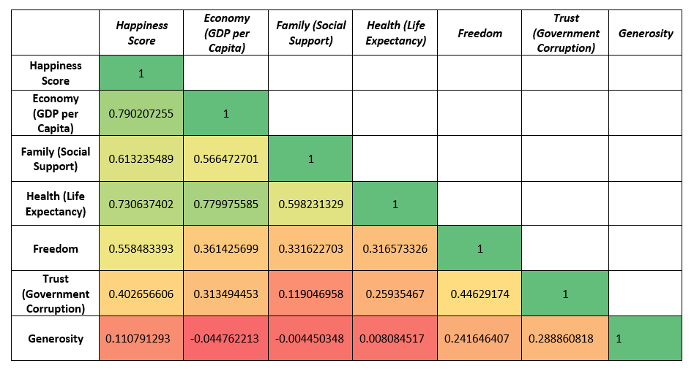
Correlation between Happiness Score and Contributing Factors
Notes:
A correlation map is used to measure the correlation between two or more variables
The Economy (GDP per capita) score tends to have the biggest impact on the Happiness Score around the World followed by the Health score
Also, there is a strong correlation between Economy and Health (Life Expectancy), this can be due to the fact that countries with high economies can provide better health facilities to their citizens
Family (Social Support) and Freedom have a moderate impact on the Happiness Score
Trust (Government Corruption) and Generosity scores have the least impact on the Happiness Score
There is also some correlation between Freedom and Trust in Government, meaning that citizens of countries that have more freedom tend to trust their Government to some extent

Slide 18
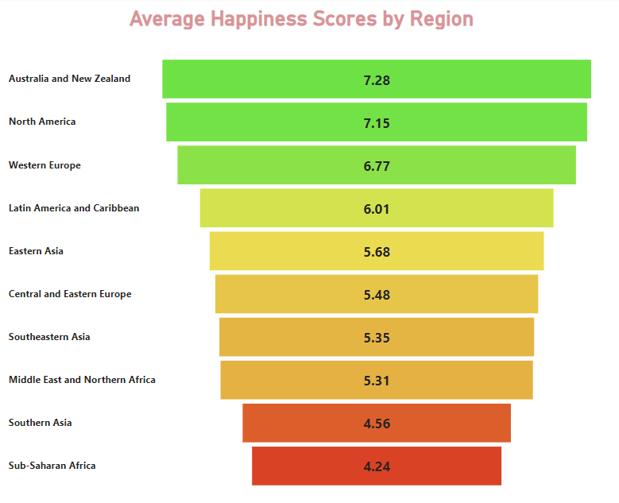
Analysis by Region
Notes:
The following tunnel graph shows the Average Happiness Scores across different Regions of the World
Australia and New Zealand are the Happiest Region followed by North America, whereas Southern Asia and Sub-Saharan Africa are the Unhappiest Regions in the World

Slide 19
Analysis by Region
Notes:
Distribution of different factors that contribute to the Happiness Score for different Regions across the World can be seen from this graph
The 3 Happiest Regions (Australia & New Zealand, North America, and Western Europe) also have high values of contributing factors while the Unhappiest Regions (Southern Asia and Sub-Saharan Africa) have low corresponding values of the contributing factors

Slide 20
Analysis by Countries

Slide 21
Analysis by Countries

Slide 22
Analysis by Countries

Slide 23
Analysis by Countries
Notes:
The 5 most happy countries have corresponding high values of all six contributing factors in almost same proportion

Slide 24
Analysis by Countries
Notes:
The 5 most unhappy countries have corresponding low values of all six contributing factors in almost same proportion
Only Syria has high values of Economy and Health, but still has a low Happiness Score
Central African Republic has low values of all contributing factors and therefore least Happiness Score

Slide 25
Most Happiest Country

Slide 26
Most Unhappiest Country

Slide 27
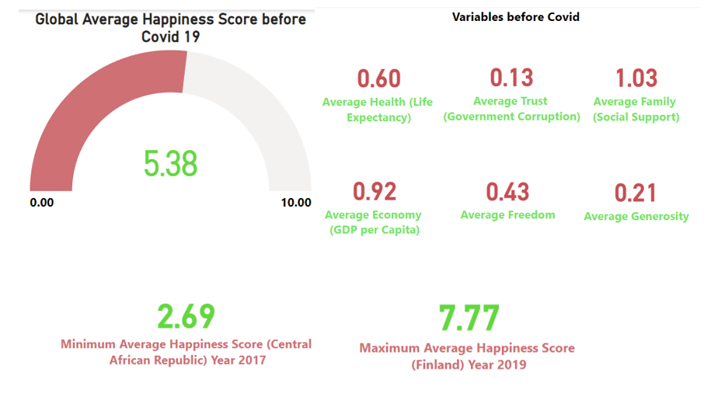
Statistics Before Covid 19

Slide 28
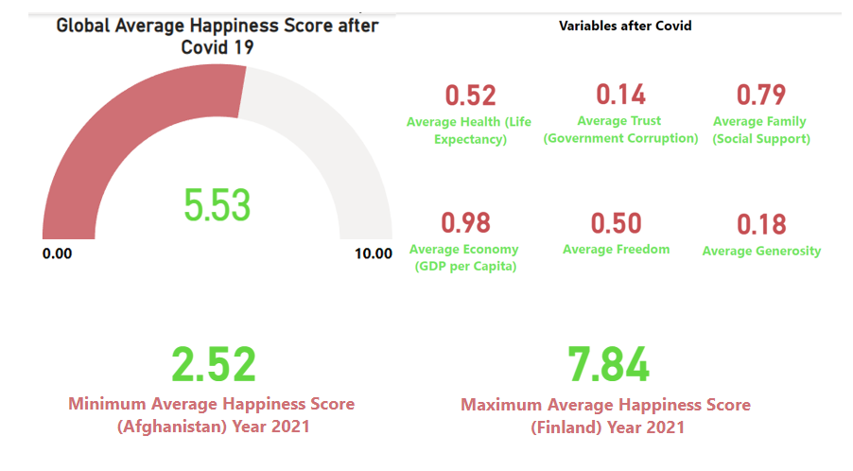
Statistics After Covid 19

Slide 29
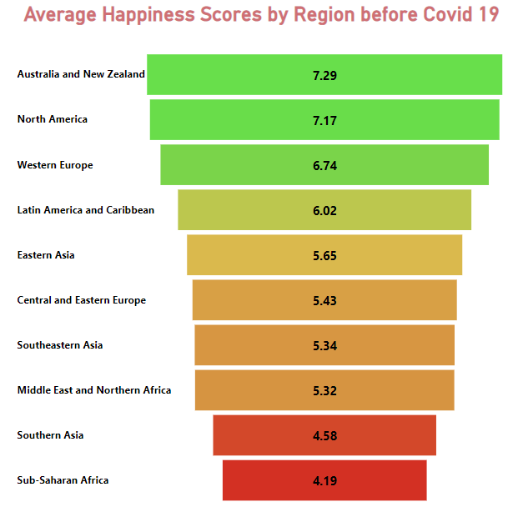
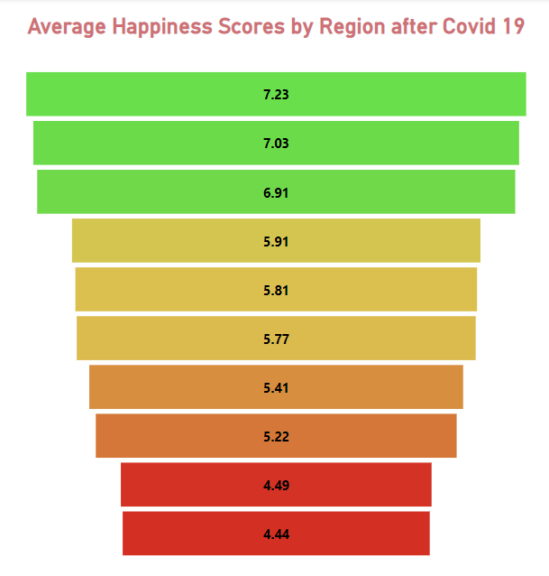
Before and After Covid 19

Slide 30
Before and After Covid 19

Slide 31
Conclusions
* Six factors in different proportions determine a country’s Overall Happiness Score
* Economy and Health are factors that contribute the most toward the Happiness Score
* Generosity and Trust in Government are the factors that contribute the least toward the Happiness Score
* The Happiest Regions are Australia & New Zealand, North America, and Western Europe
* The Unhappiest Regions are Southern Asia and Sub-Saharan Africa
* The 5 Happiest Countries are Finland, Denmark, Switzerland, Iceland, and Norway (all belong to Western Europe Region)
* The 5 Unhappiest Countries are the Central African Republic, Burundi, Syria, Afghanistan, and South Sudan (4 are from Africa
and 1 from Southern Asia)
* Despite Australia & New Zealand and North America being the Happiest Regions, the Happiness Score for these two
regions has been decreasing over the last few years
* Whereas Sub-Saharan Africa is the Unhappiest Region, the Happiness Score has been increasing over the last few
years

Slide 32
Conclusions
* The Average Happiness Score has increased after the Covid 19 pandemic (from 5.38 to 5.53)
* Finland has maintained its position as the Happiest Country before and after Covid 19 pandemic
* Countries in the same region or nearby are often affected by the same factors involved in
calculating their Happiness Score
* The Average Happiness Score has increased for Western Europe, Eastern Asia, Central & Eastern
Europe, Southeastern Asia, and Sub-Saharan Africa after the Covid 19 pandemic
* The Average Happiness Score has decreased for the rest of the Regions after the Covid 19 pandemic

Slide 33
Recommendations
* We can precisely define what makes countries and their populations happy, allowing us to emphasise and
improve key aspects of any country
* Through this, we will be able to obtain the primary aim of pleasure, which we as humans
yearn for
* To maintain and enhance the Happiness Score, we must focus on the Economy, Health, and
Family/Social Support
* With the growth in the economy, the government can invest in Health facilities and hence increase
the Health Score which can eventually contribute towards an improvement in the Happiness Score
* Since the Economy is the strongest contributor to Happiness Score, a country having a low Happiness Score
should first work towards increasing its Economy
* Obtaining better ratings in Social Support, Trust, and Freedom in less or more proportion may contribute
towards better Happiness Scores for a country

Slide 34
Recommendations
* Governments should increase Social Support by creating more Social
communities which might contribute to the Happiness Score
* Further experiments can be performed to establish causal relationships
between different variables and tested using Hypothesis Testing
* Regression and Predictive Analysis techniques can be used to predict the
Happiness Score of a Country or a Region if more data is available

Slide 35
Thank You

